Slide 1
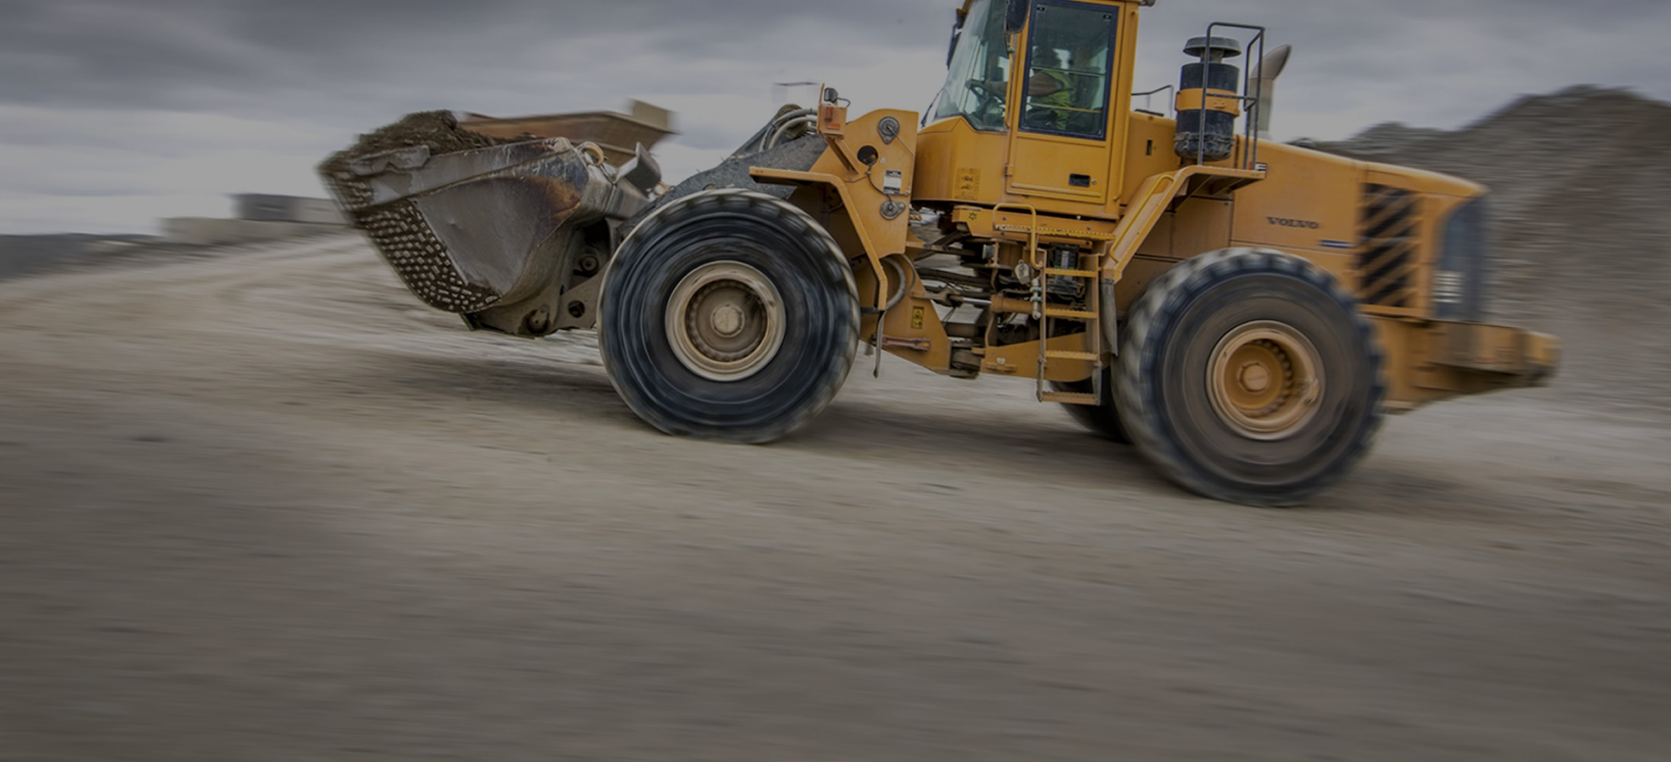
Quarry Health & Safety Management System Template
Wayne Scott - CEO MinEx
21 July 2017
wayne@minex.org.nz
mobile: 021 944 336
www.minex.org.nz
www.minex.org.nz
Notes:
Need thank AQA and IOQ for the invitation to speak. MinEx has a stand along with AQA, IOQ & WorkSafe and there will be someone in attendance through out the conference so only too happy to talk to you there about MinEx and how we can assist with H&S matters.

Slide 2
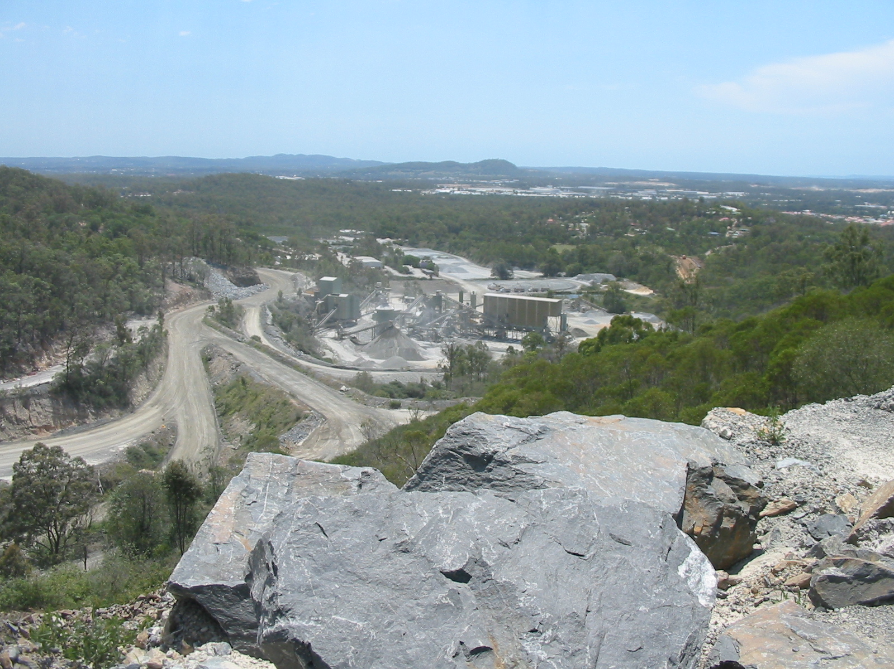
A little bit about me…
www.minex.org.nz
www.minex.org.nz
Notes:
Has MinEx finished what it was set up to achieve?
Safe mines : Safe workers came out in May 2013 & we now have regulations for the mining sector that are essentially fit for purpose
But – there is a need to make amendments to correct errors & omissions & these are required now . We are working actively with WorkSafe on this, but facing resistance elsewhere in Government & MinEx &Straterra are lobbying to address this
The regulations need to be supported by codes & guidelines to help mine & quarry operators know what they need to do to comply & there is a lot of work to do here
Codes & guidelines are important documents that the courts will use in the event of a prosecution
The codes & guidelines programme consists of 14 key documents – 2 completed, 3 underway leaving 9 yet to commence

Slide 3
My thoughts on where we need to go with Health & Safety in the workplace
Focus on fatal hazards
Effective risk management practices
Training and competency
www.minex.org.nz
Notes:
Has MinEx finished what it was set up to achieve?
Safe mines : Safe workers came out in May 2013 & we now have regulations for the mining sector that are essentially fit for purpose
But – there is a need to make amendments to correct errors & omissions & these are required now . We are working actively with WorkSafe on this, but facing resistance elsewhere in Government & MinEx &Straterra are lobbying to address this
The regulations need to be supported by codes & guidelines to help mine & quarry operators know what they need to do to comply & there is a lot of work to do here
Codes & guidelines are important documents that the courts will use in the event of a prosecution
The codes & guidelines programme consists of 14 key documents – 2 completed, 3 underway leaving 9 yet to commence

Slide 4
Our main purpose is to assist in improving health and safety performance, and provide centralised industry representation, particularly to Government, in matters relating to health and safety
Our Goals
To support the industry to achieve a 50% reduction in injuries on 2016, by 2021
To provide resources to the industry to enable improved health and safety performance
To work effectively with Government to develop appropriate and practical Regulations and Codes of Practice for the industry and to ensure these are appropriately implemented and enforced
To communicate effectively with other stakeholders on the industry’s behalf
www.minex.org.nz
www.minex.org.nz
Notes:
Does the industry & the quarry sector need MinEx?
Mines and quarries under pressure from government and public, post Pike River and now. We need to show leadership and better safety performance
The new MinEx: a partnership between the mining & quarry sectors including the union (EPMU) was formed in April 2013 with 5 yr business plan to:
Work with MBIE in 2013 to ensure we had fit for purpose regulations
Work with WorkSafe thereafter to ensure we had fit for purpose support to the regulations via codes & guidelines
Work with industry to improve H&S to meet industry & government targets

Slide 5
How we operate
Funded by the quarry and mining industries
Our CEO works out of the Straterra office assisted by a communications advisor, secretariat, working groups within industry and with links to other industry groups (i.e FISC)
Good access through Straterra to WorkSafe, MITO, MBIE, MP’s/Ministers and others
Our board has representatives across quarrying, mining, tunneling, professional bodies and the union
www.minex.org.nz
Notes:
Has MinEx finished what it was set up to achieve?
Safe mines : Safe workers came out in May 2013 & we now have regulations for the mining sector that are essentially fit for purpose
But – there is a need to make amendments to correct errors & omissions & these are required now . We are working actively with WorkSafe on this, but facing resistance elsewhere in Government & MinEx &Straterra are lobbying to address this
The regulations need to be supported by codes & guidelines to help mine & quarry operators know what they need to do to comply & there is a lot of work to do here
Codes & guidelines are important documents that the courts will use in the event of a prosecution
The codes & guidelines programme consists of 14 key documents – 2 completed, 3 underway leaving 9 yet to commence

Slide 6
How MinEx can help you
Regular advice on H&S matters as they unfold to ensure you are up-to-date with new developments and requirements.
Opportunity for input to the WorkSafe code and guidance programme to ensure that we have fit-for-purpose outcomes.
Access to resources to assist you in developing and maintaining compliant H&S systems. Advice and assistance on training issues including COC’s, Professional Development and worker training
Regular Safety Alerts and H&S statistics as a tool to bench-mark and improve industry H&S performance
www.minex.org.nz
www.minex.org.nz
Notes:
Does the industry & the quarry sector need MinEx?
Mines and quarries under pressure from government and public, post Pike River and now. We need to show leadership and better safety performance
The new MinEx: a partnership between the mining & quarry sectors including the union (EPMU) was formed in April 2013 with 5 yr business plan to:
Work with MBIE in 2013 to ensure we had fit for purpose regulations
Work with WorkSafe thereafter to ensure we had fit for purpose support to the regulations via codes & guidelines
Work with industry to improve H&S to meet industry & government targets

Slide 7
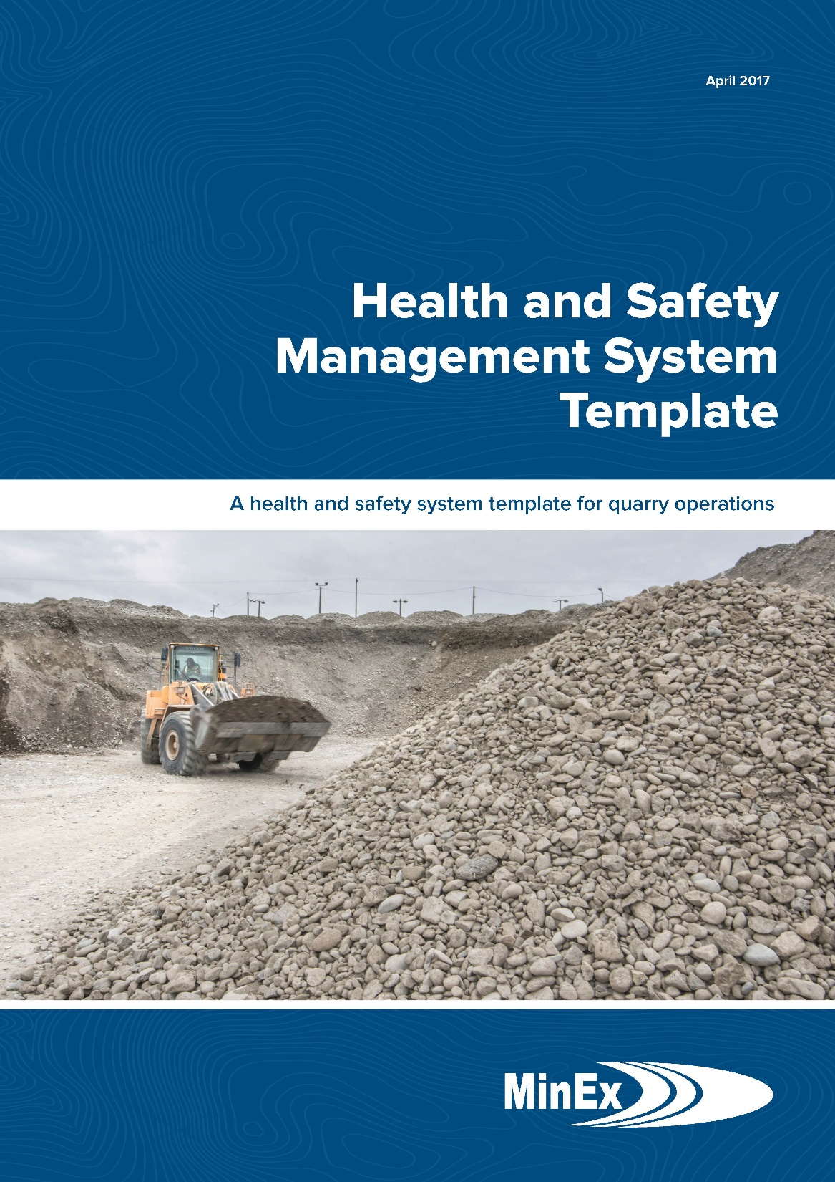
Notes:
Where does the quarry sector fit in all of this?
Quarry sector numbers dominated by small operations with less well developed H&S systems
Many small quarry operators are not engaged with industry organisations
With only 270 odd notifications it is likely that many small quarry operators have not notified WorkSafe of their statutory manager appointments (section 24)
There are no sector specific regulations applying to the quarry sector
H&S performance is far from satisfactory, and is unacceptably below that of the rest of the mining industry

Slide 8
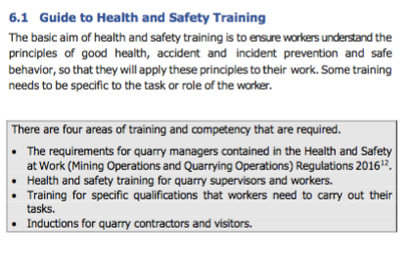
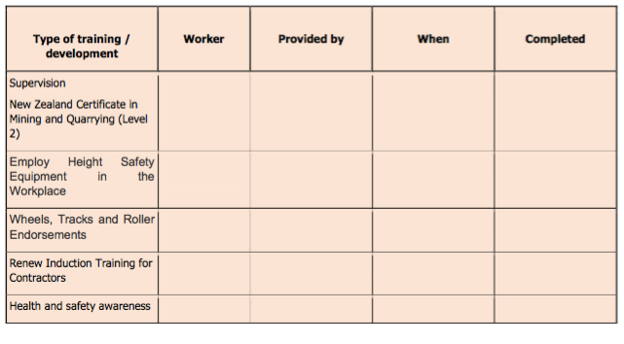
www.minex.org.nz
www.minex.org.nz
Notes:
What does all of this mean?
The work MinEx has been doing hasn’t been completed
While the regulations, code & guideline work has a finite end, the task of improving H&S performance in the industry is a long term task
All sectors of the industry need to work on H&S improvement to meet government targets, including the quarry sector
Straterra, representing those sectors covered by the 2013 regulations, supports MinEx continuing to work on H&S

Slide 9
Wayne Scott
wayne@minex.org.nz
mobile: 021 944 336
www.minex.org.nz
www.minex.org.nz
Notes:
Need thank AQA and IOQ for the invitation to speak. MinEx has a stand along with AQA, IOQ & WorkSafe and there will be someone in attendance through out the conference so only too happy to talk to you there about MinEx and how we can assist with H&S matters.

